Slide 1
Process
Move to cookies station
Machine-Pro
Create Cookies
Classify
Scaling cookies
Input
PC
Stored
pp
Crusher
Scaling Re-pp
Process
others
Machine-EX
Sell
_ Date
_ shift
_ MC no.
_ Step
_ Screw size
_ Speed
_ Item
_cause:
+ Color change
+ Color variation/testing
+ Black dot
+ Mold change
+ MC stop
_Purging usage
_ Type of cookies + TPU ( 80%) + PP ( 80%)
+ Mix
_ Cookies Weight
_report with chart from data base
+ Cookies weight by MC
+ cookies weight by cause
+ Cookies weight by Item + Total cookies weight by date + Cookie vs cookie ( TPU,Mixed,PP
+ Average pp input from A color to B color
+ average PP input with screw size
_report with from pc interface scaling screen + Daily Cookies by shift
+Daily data cookies by shift
+ weekly purging
+ Average PP input by top color change
Information

Slide 2
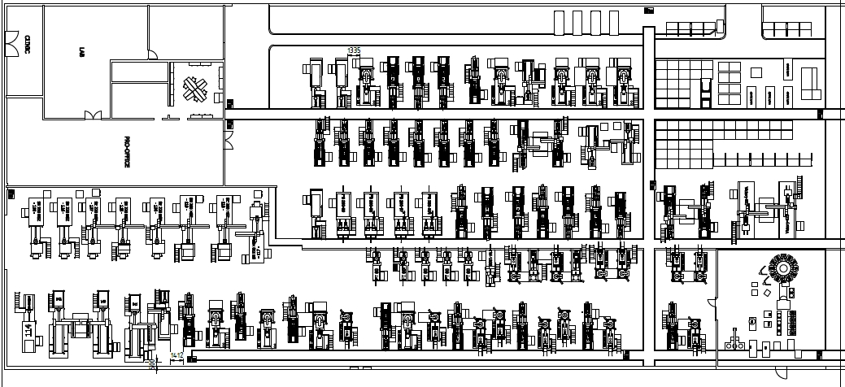
Scaling station location
PC

Slide 3
Scaling station interface version 1
Purge Date
Shift
New
Cancel
Machine No
Auto search
Item
Component
Screw size
Color change
Purging material
Purging input
Purging cookies
TPU cookies
Mixed cookies

Slide 4
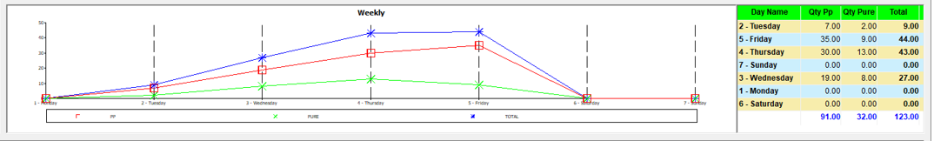
Scaling station interface version 2
Purge Date
Shift
New
Cancel
Machine No
Auto search
Item
Component
Screw size
Color change
Purging material
Purging input
Purging cookies
TPU cookies
Mixed cookies

